Slide 1
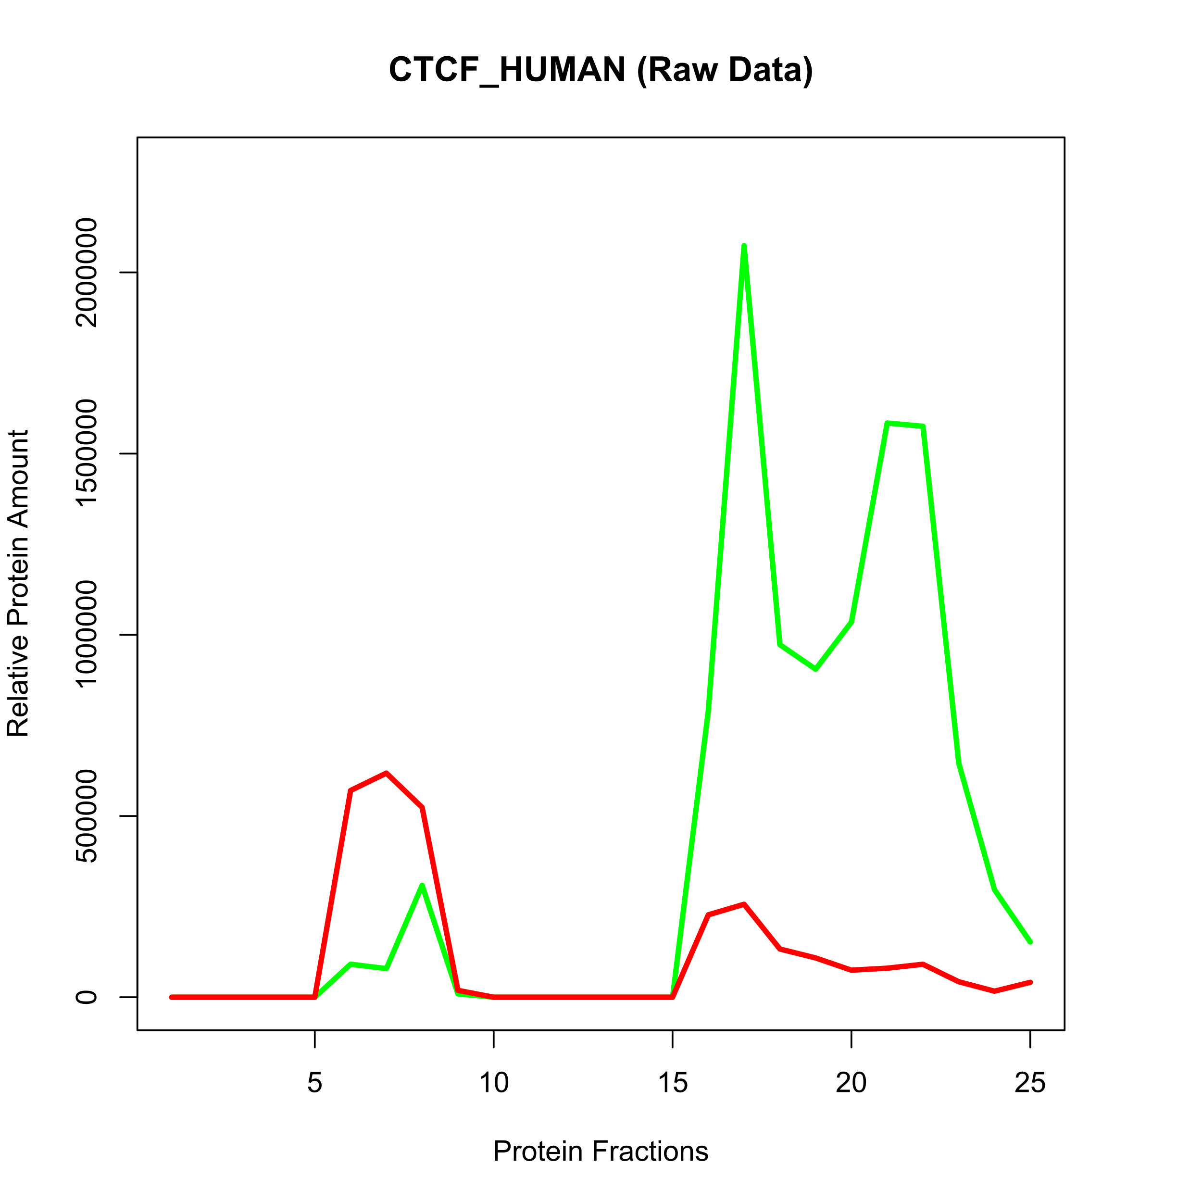
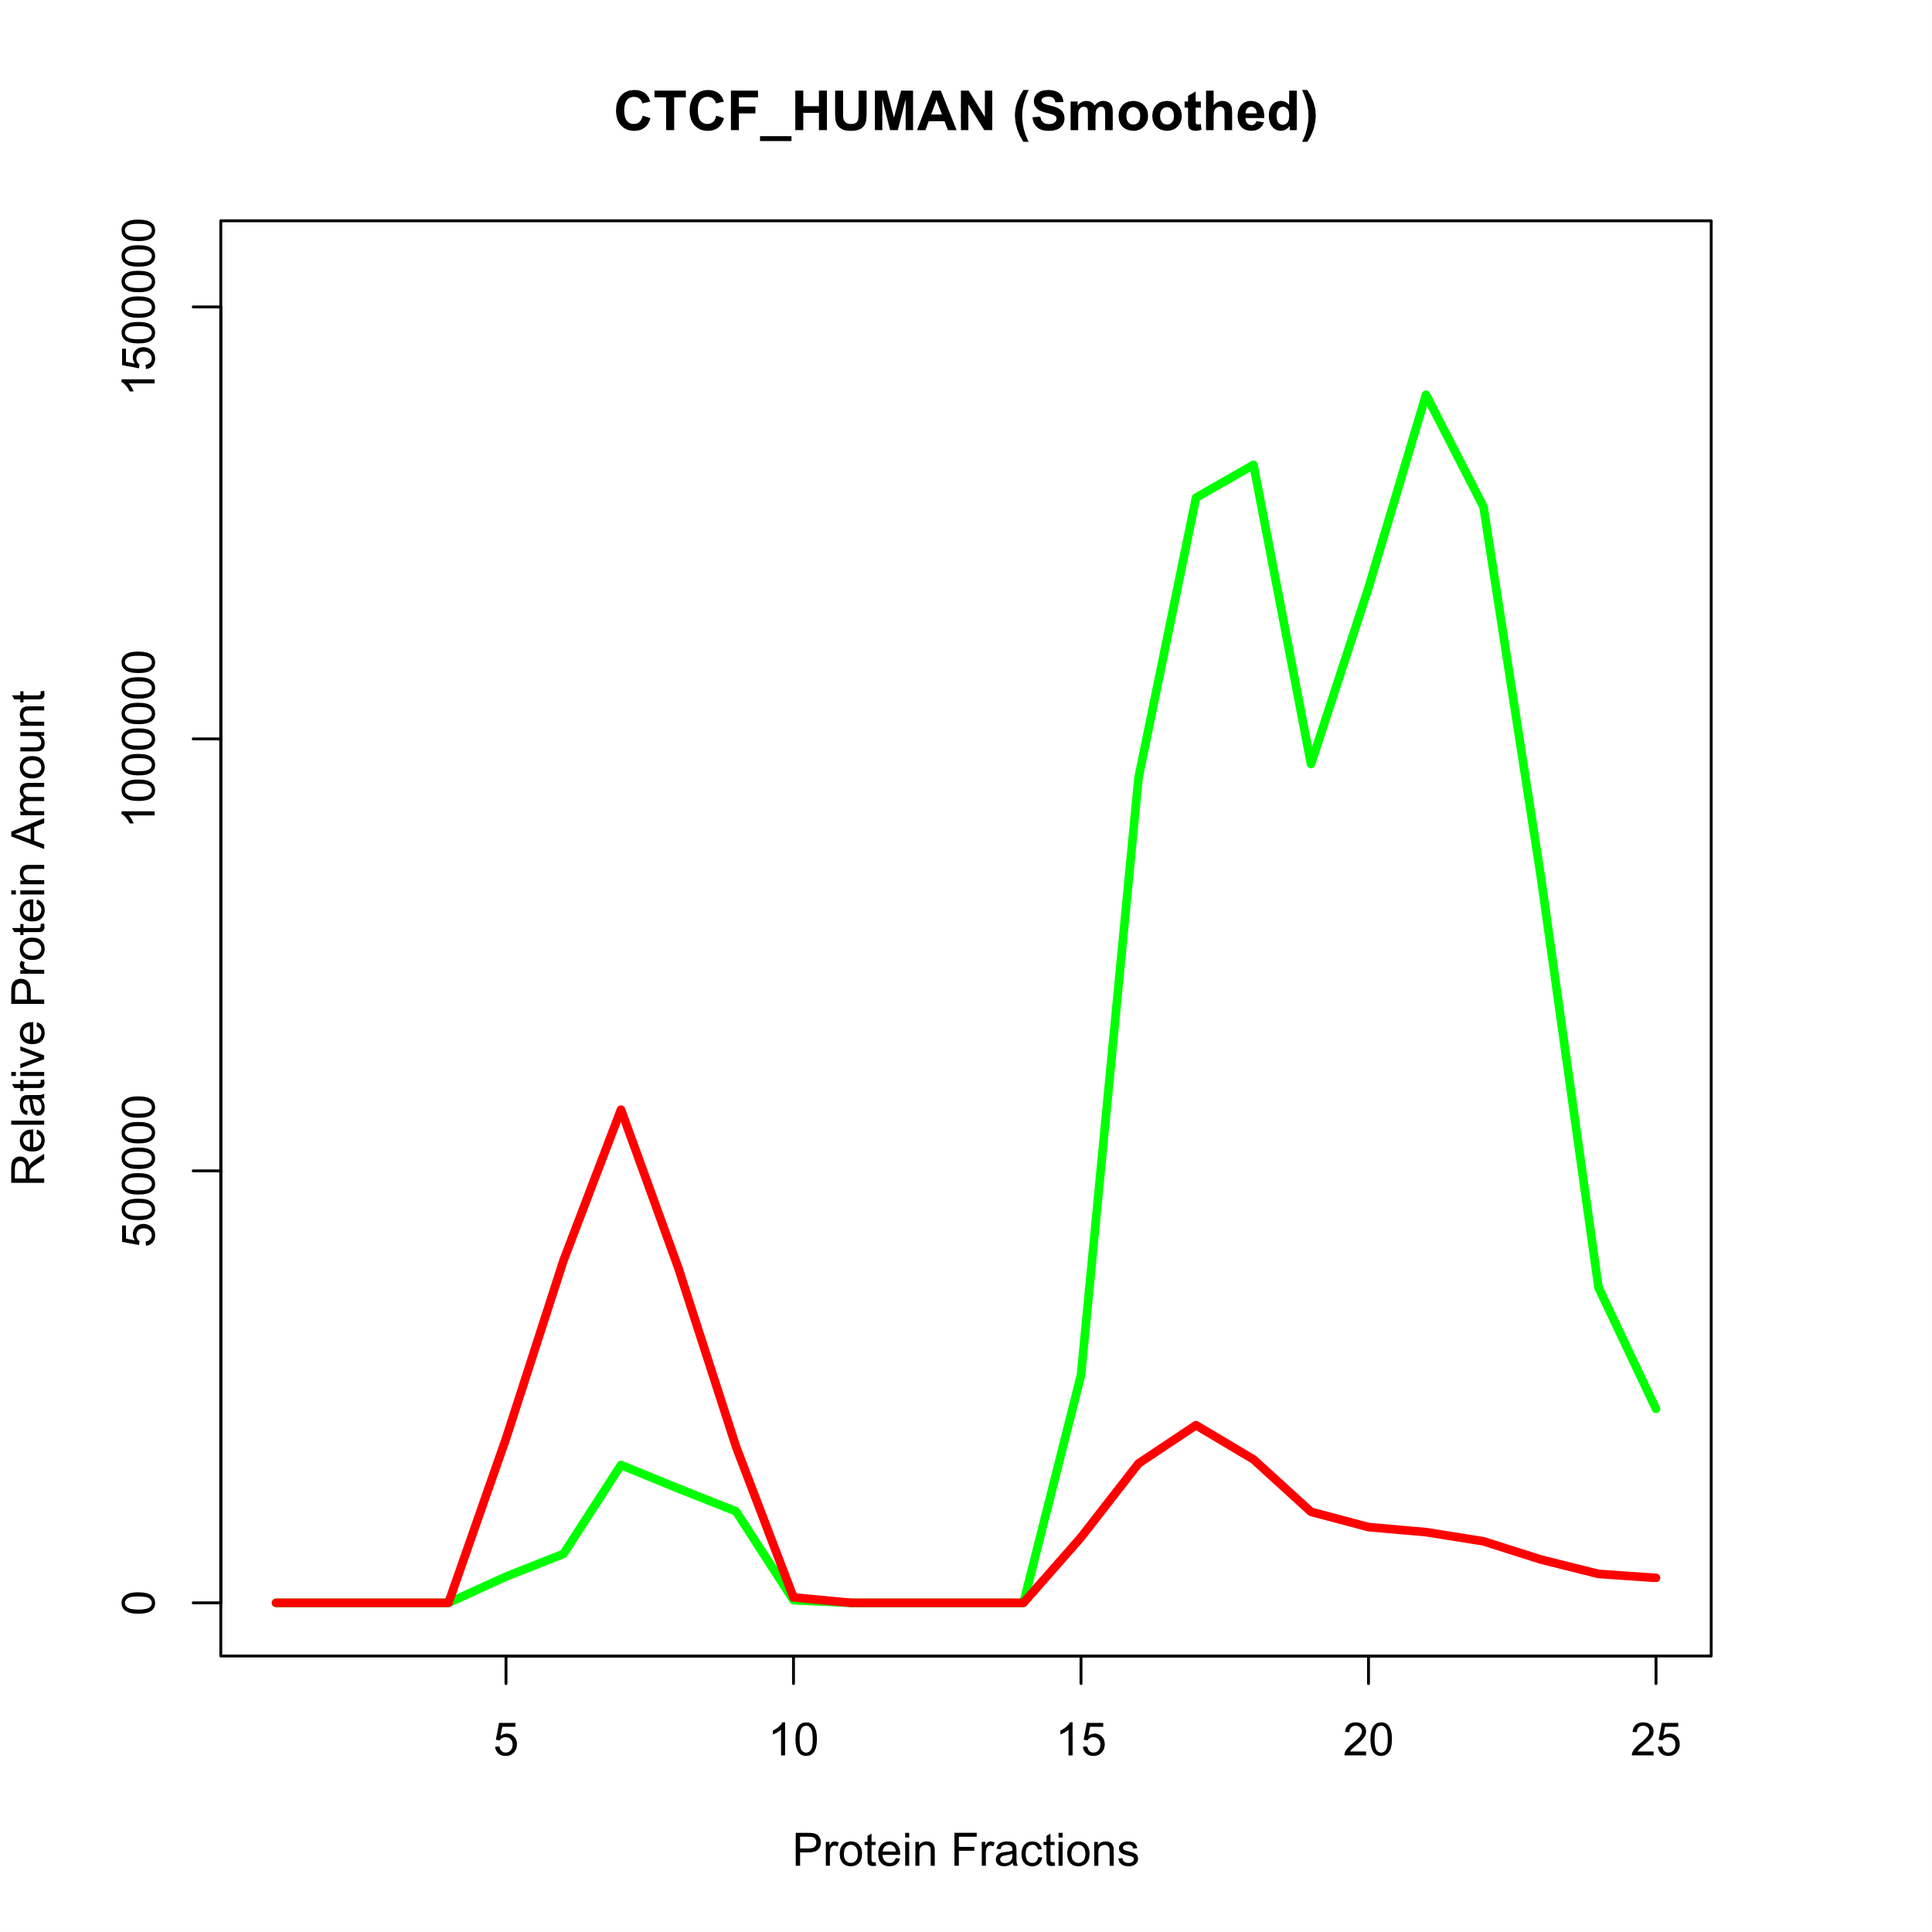
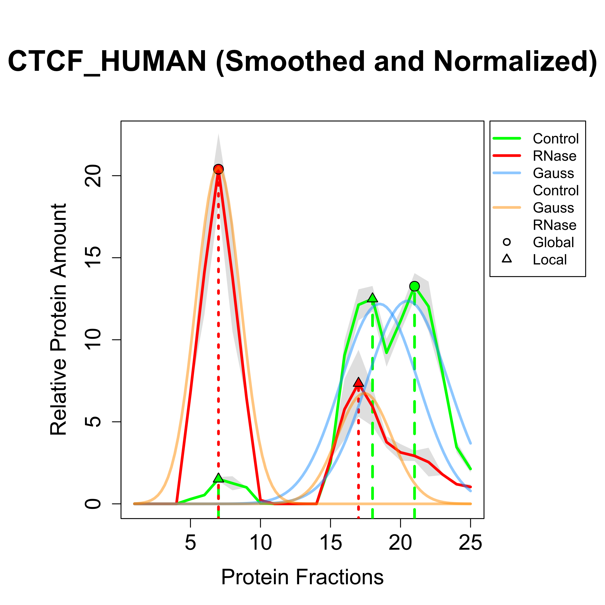
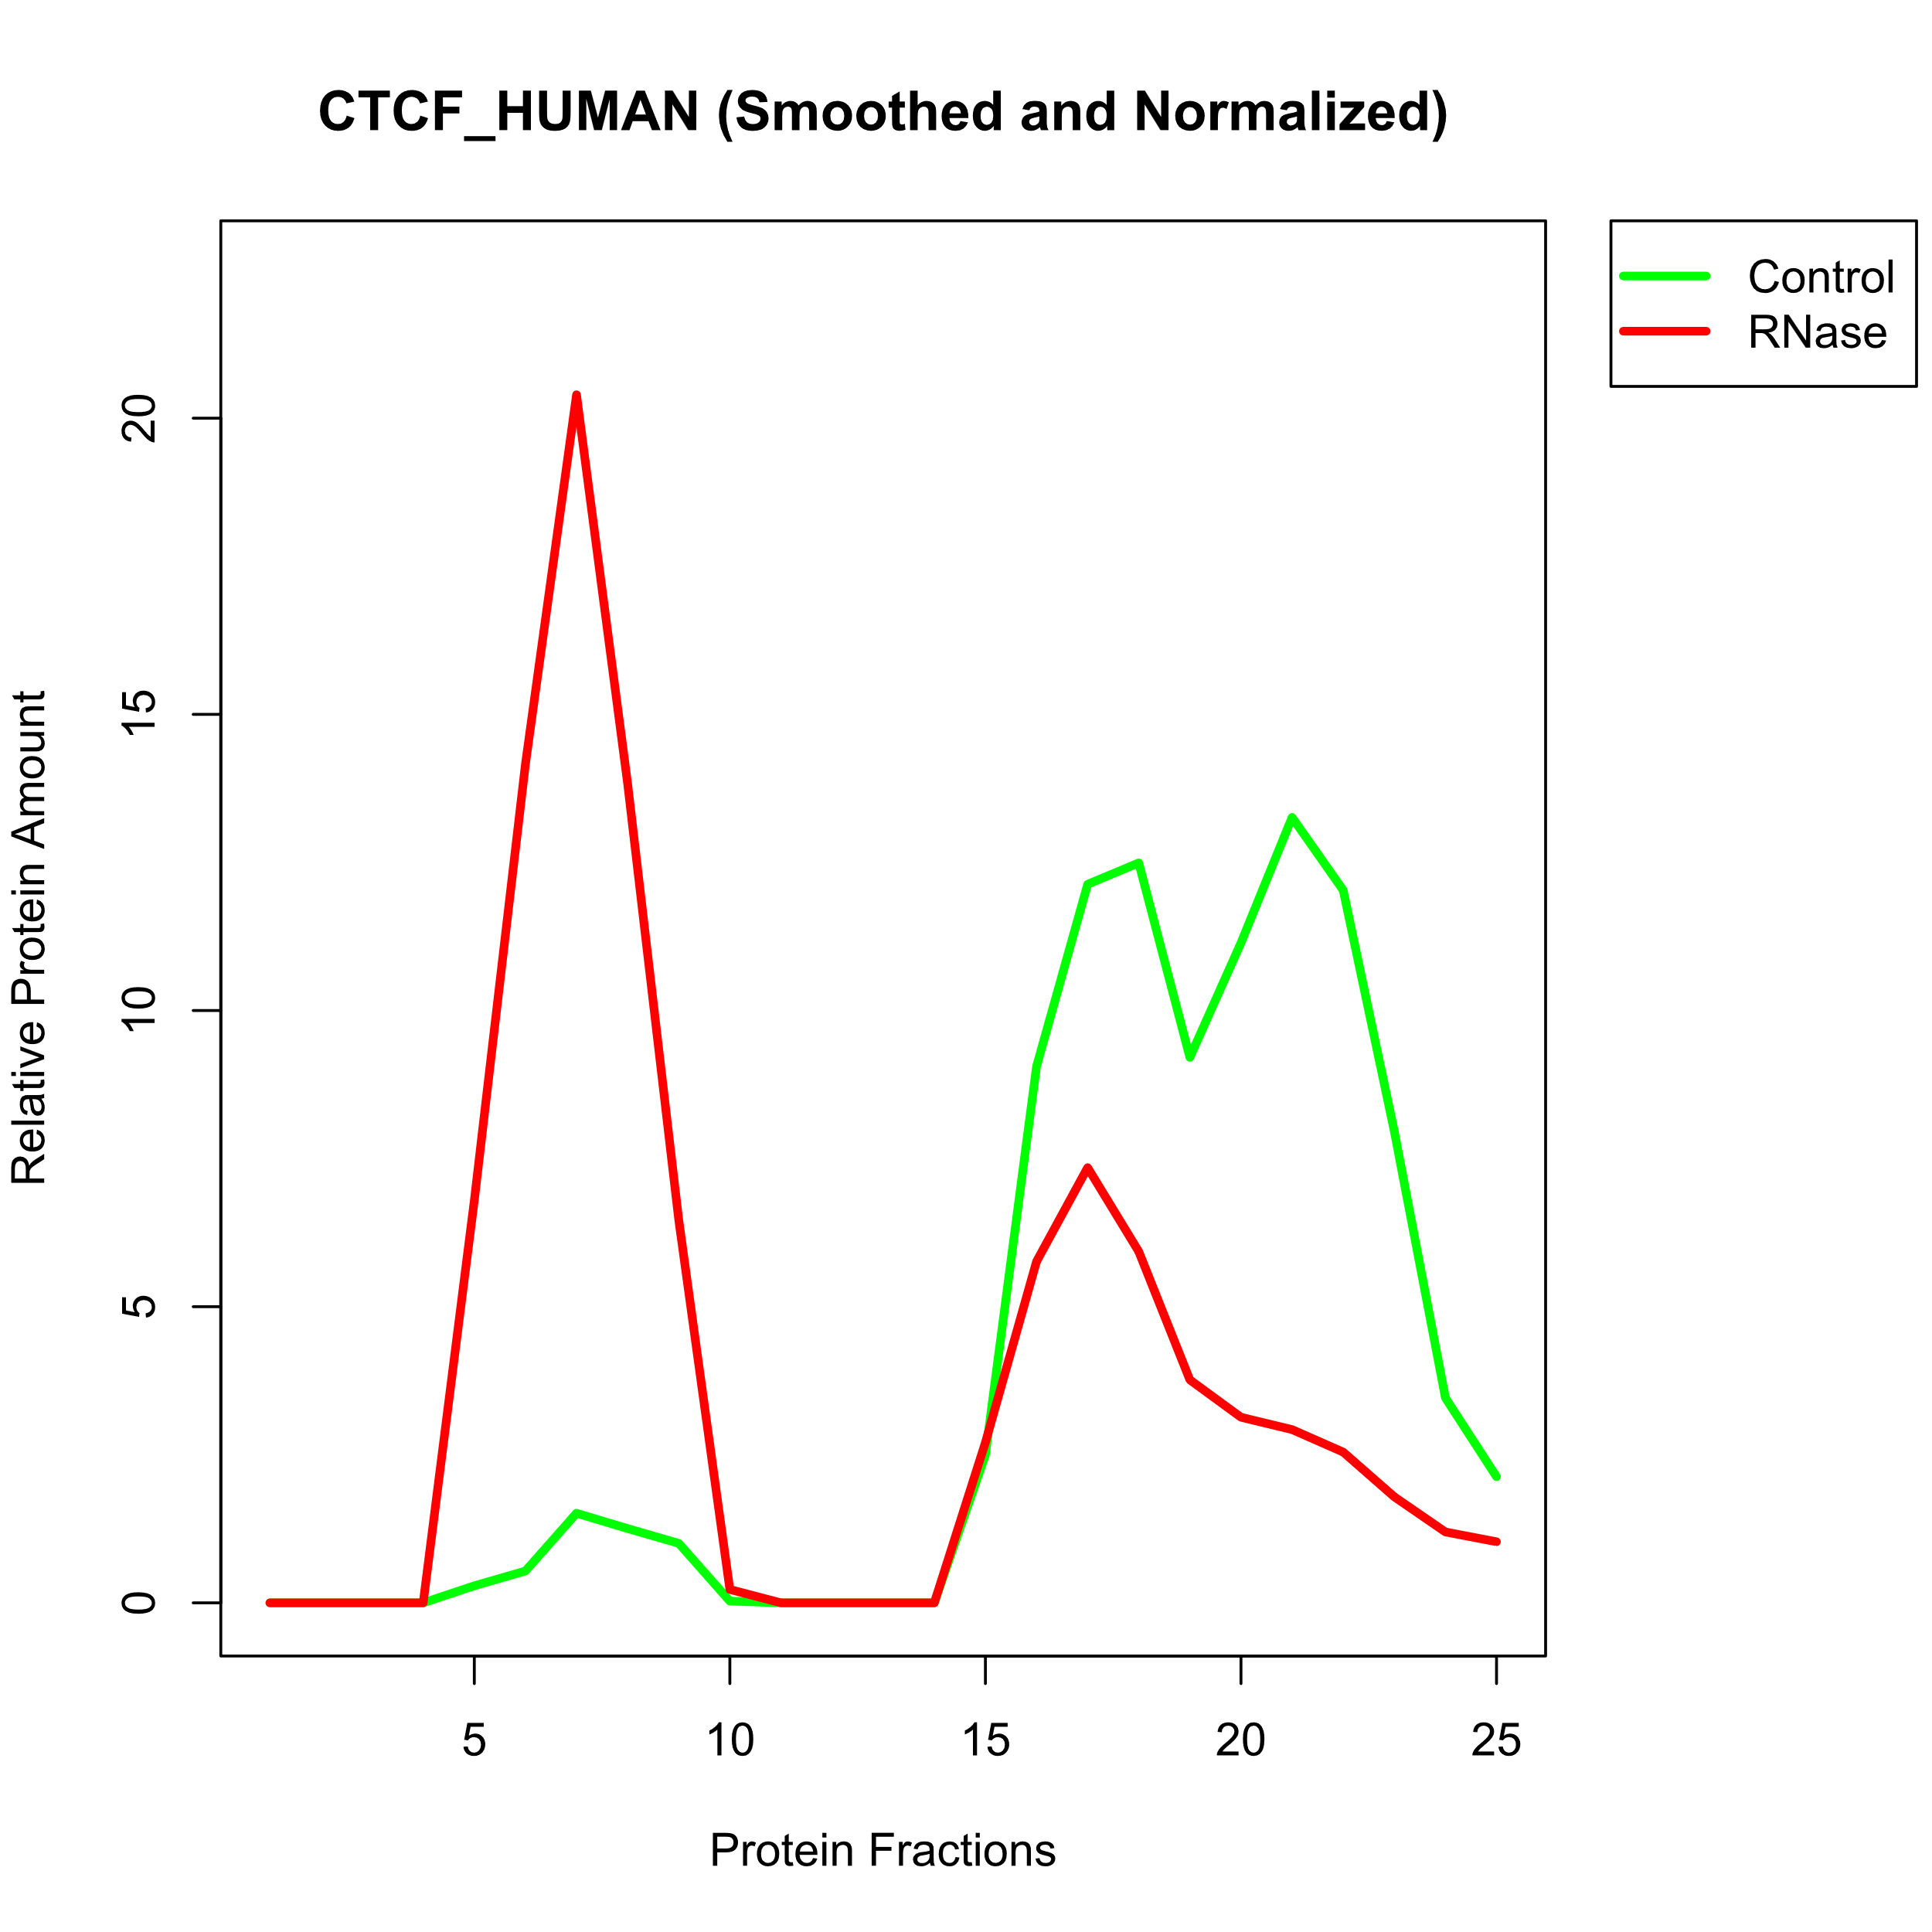
Biological Background • Methods • Results • Outlook
05
Smoothing, Normalization & Gaussian Fitting
Proteome-wide Screen for RNA-dependent Proteins I Team 3: HeLa Cells Synchronized in Interphase I Summer Term 2023 I 19.07.2023 I Supervisor: Dr. Maïwen Caudron-Herger

Slide 2
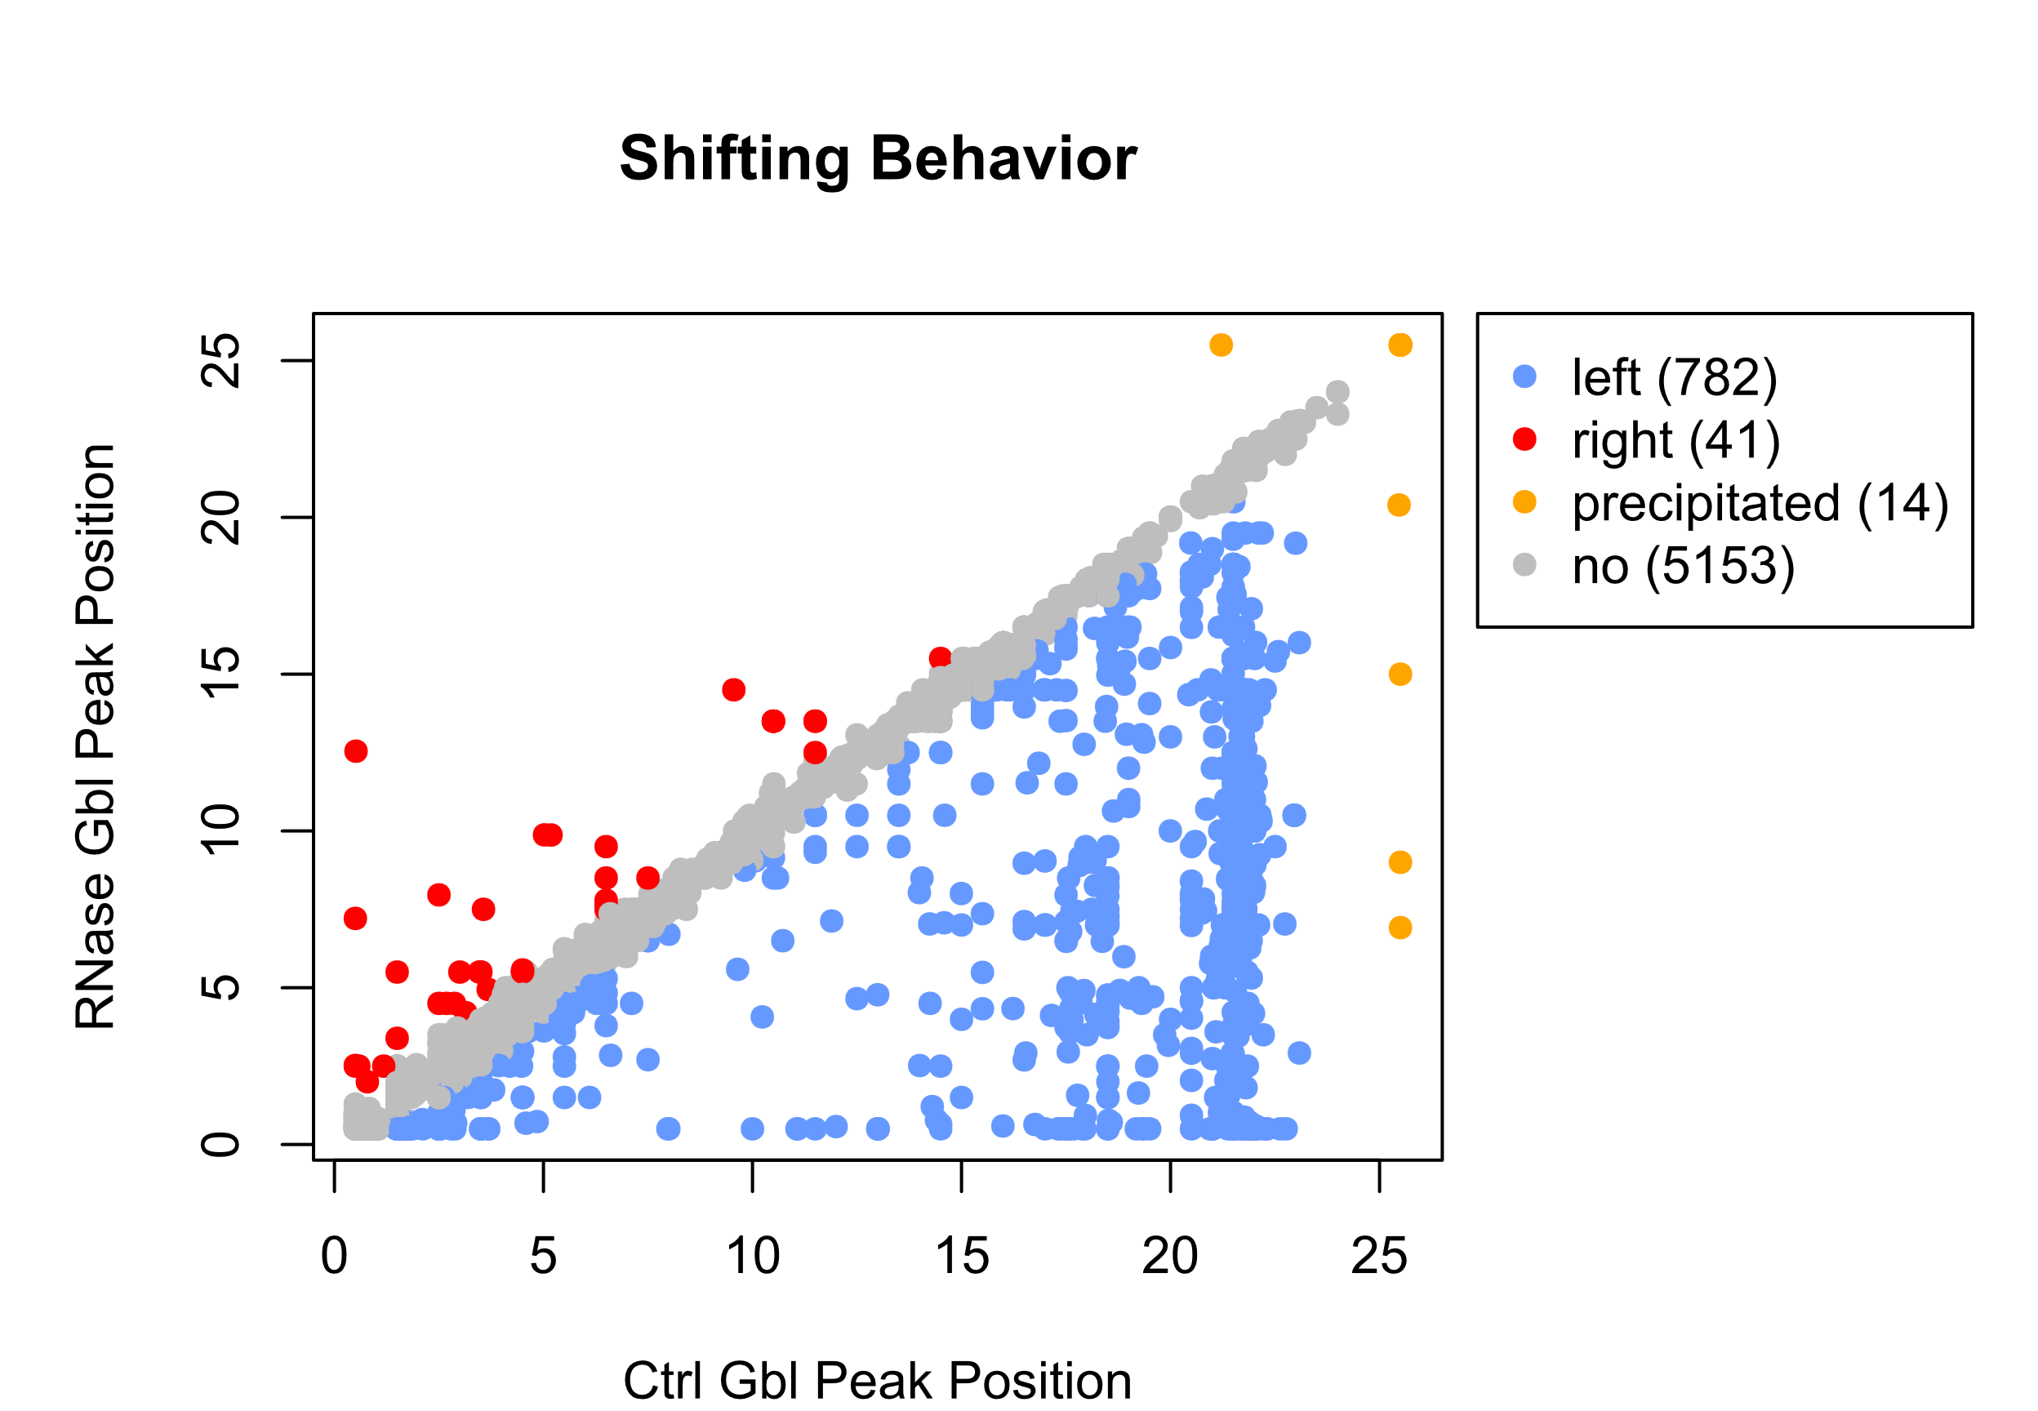
Biological Background • Methods • Results • Outlook
06
Shifting Behavior
Proteome-wide Screen for RNA-dependent Proteins I Team 3: HeLa Cells Synchronized in Interphase I Summer Term 2023 I 19.07.2023 I Supervisor: Dr. Maïwen Caudron-Herger

Slide 3
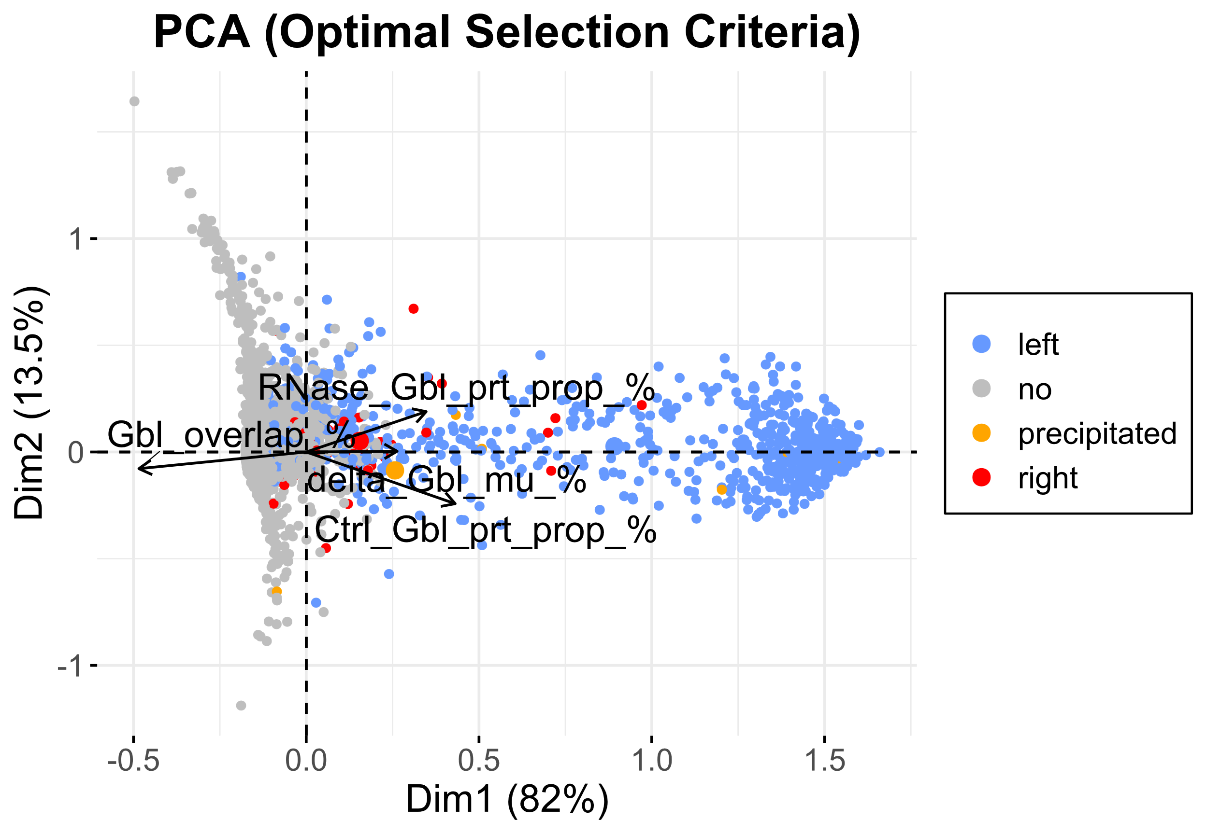
Biological Background • Methods • Results • Outlook
07
Principle Component Analysis
Proteome-wide Screen for RNA-dependent Proteins I Team 3: HeLa Cells Synchronized in Interphase I Summer Term 2023 I 19.07.2023 I Supervisor: Dr. Maïwen Caudron-Herger

Slide 4
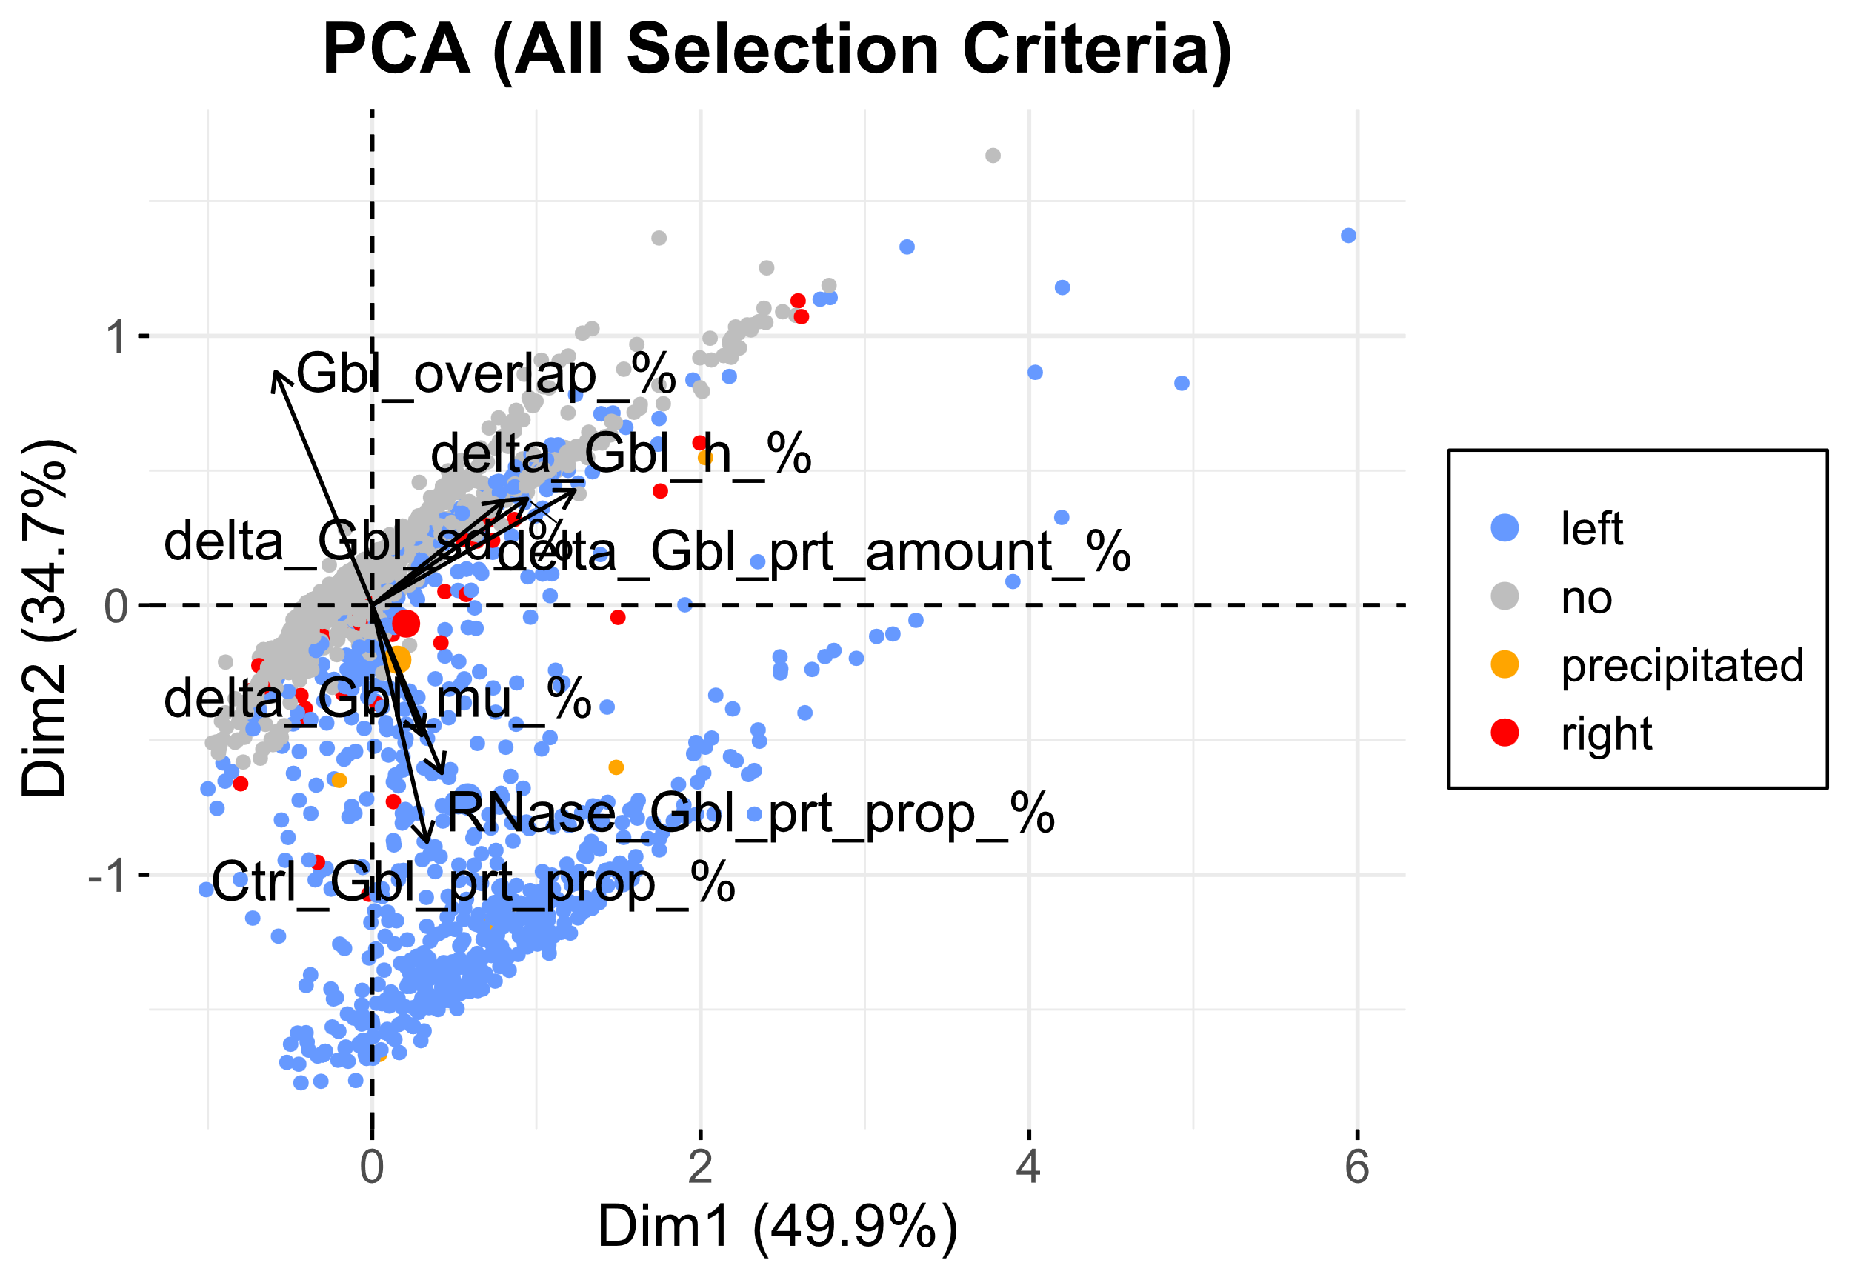

Principle Component Analysis

